Slide 1
Professional Facebook Profile –Bella Swan

Slide 2
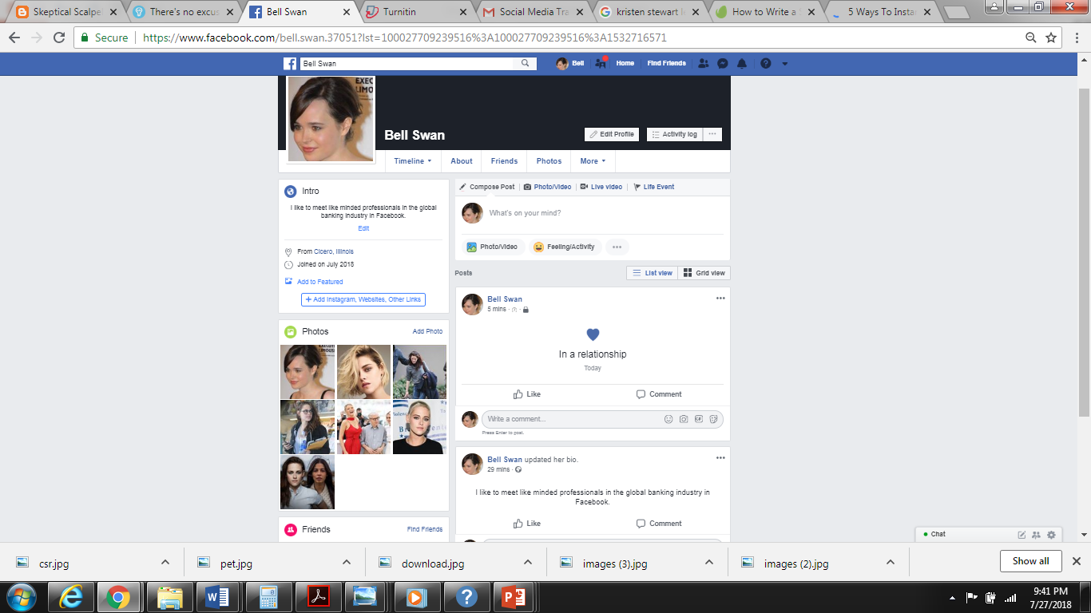

Slide 3
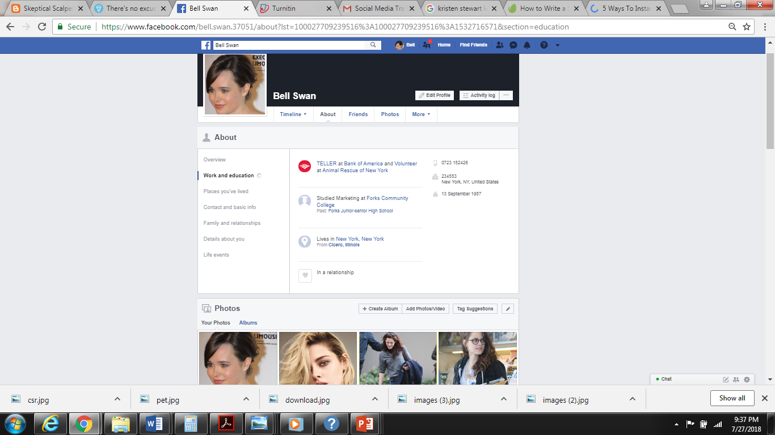

Slide 4
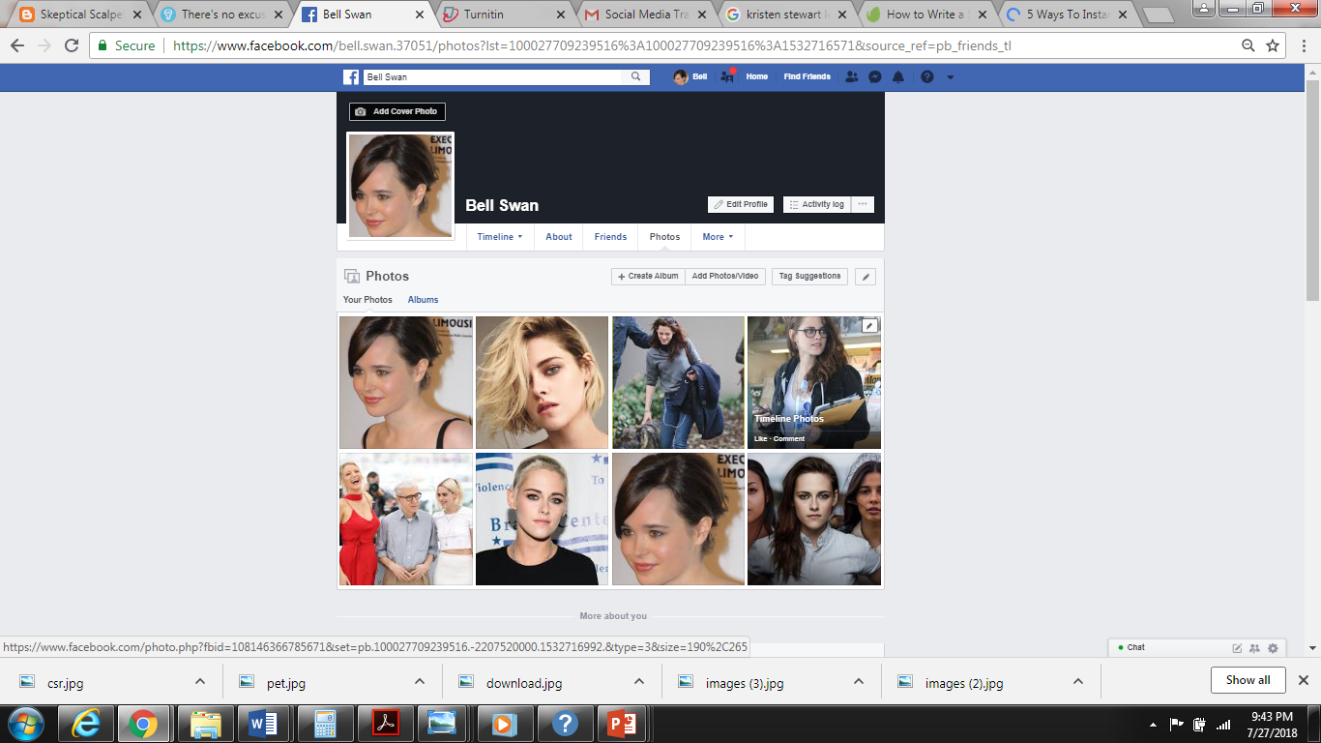

Slide 5
